Slide 1
Daily Data Aggregation
~By
Alekhya Krishna Balivada

Slide 2
Agenda
Project Statement
Project Overview
Project Requirements
Architecture
Execution overview
Project implementation
Conclusion

Slide 3
Project Statement
Implement a daily data aggregation pipeline using Azure Data Factory to move raw data and Azure Databricks to aggregate and summarize the data based on daily intervals.

Slide 4
Project Overview
The project aims to use Azure Data Factory (ADF) and Azure Databricks to construct a daily data aggregation pipeline. With the help of this pipeline, raw data from source systems will be moved to a location where Azure Databricks will be used for daily data aggregation and summarization

Slide 5
Project Requirements
Azure Subscription
Data Sources
Azure Storage account
Azure Databricks
Azure Data Factory

Slide 6
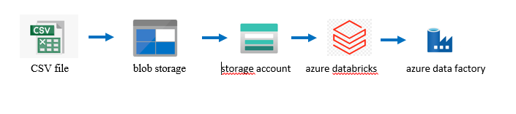
Architecture

Slide 7
Execution Overview
Login to the Azure Subscription account.
Create a storage account and upload a file inside a storage account container.
Create an Azure Databricks workspace.
Create a cluster and notebook in databricks workspace.
Connect ADLS with ADF.
Create Azure data factory resource.
Create pipeline for databricks in ADF.
Debug to get the final output.

Slide 8
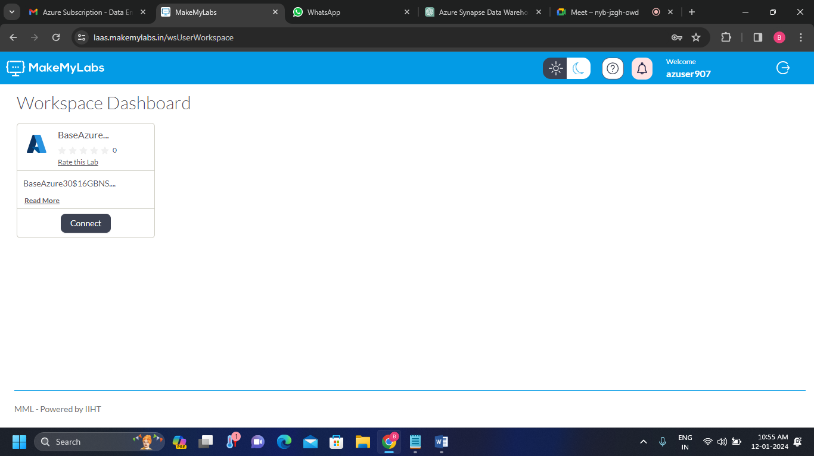
Project Implementation
1. Azure account:
Log in to the Azure account and connect to the Workspace Dashboard.

Slide 9
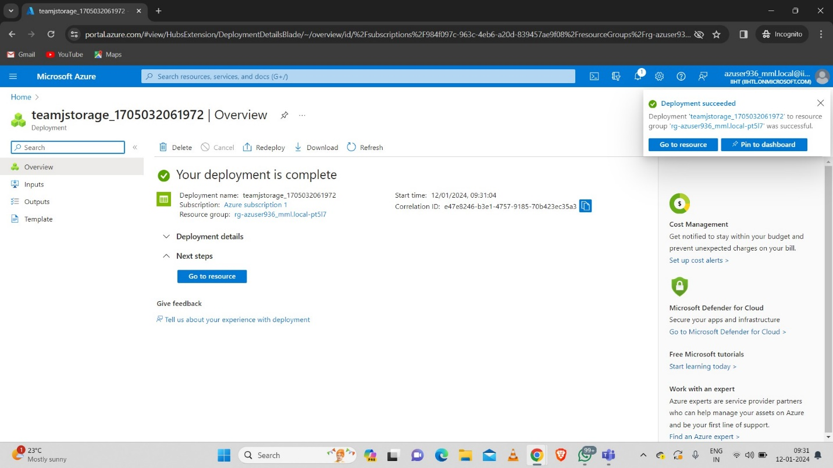
2. Storage Account
Create a Storage account.

Slide 10
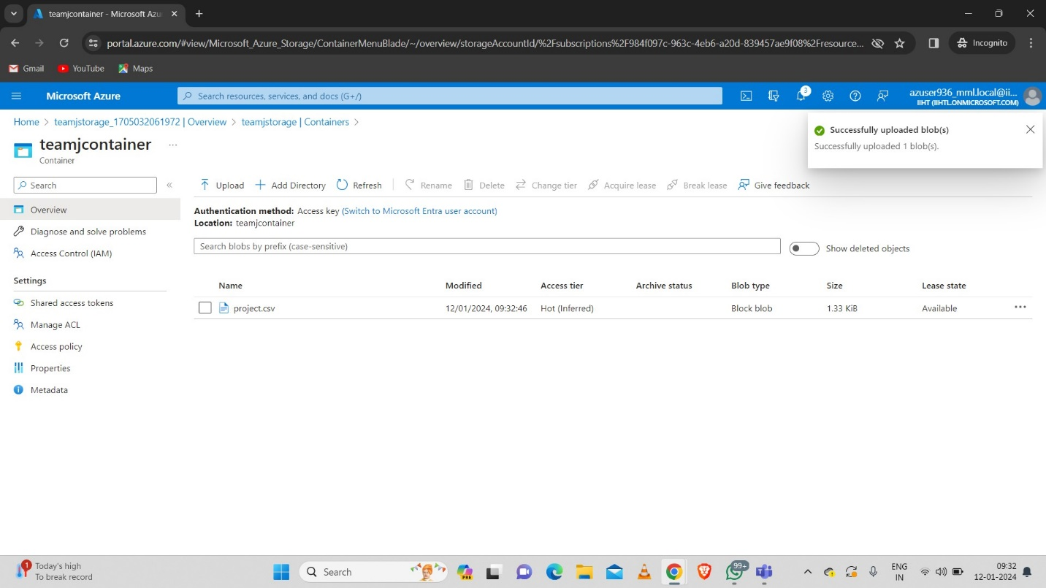
3.Uploading CSV File In Storage Account Container
Upload the file inside the container.

Slide 11
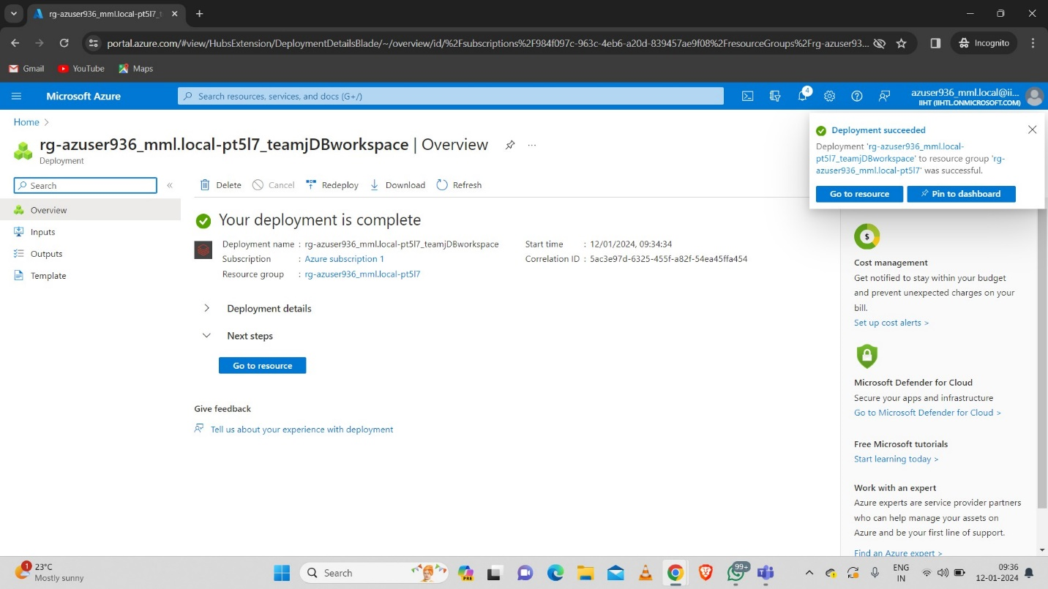
4. Azure Databricks
Create an Azure databricks Workspace.

Slide 12
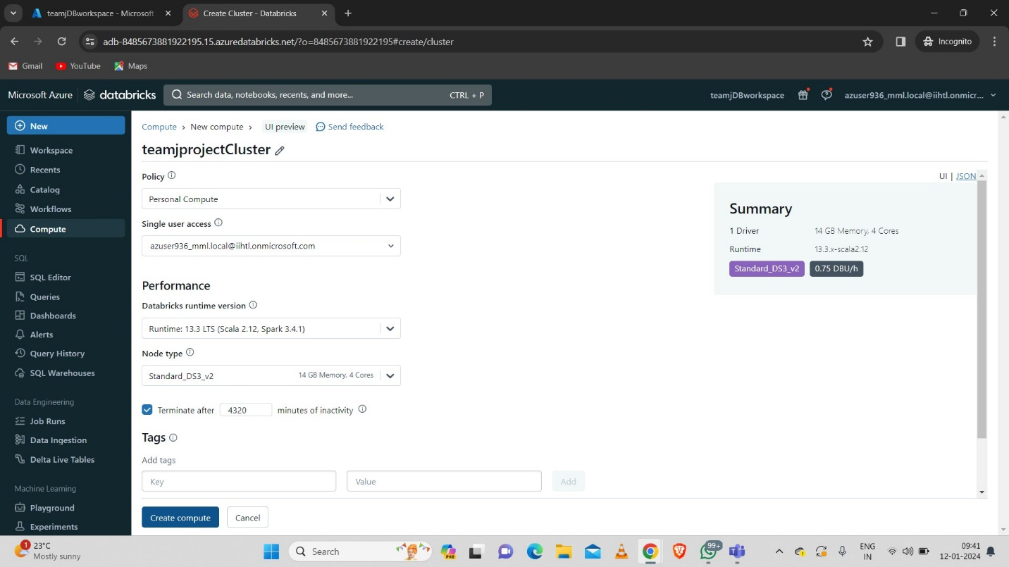
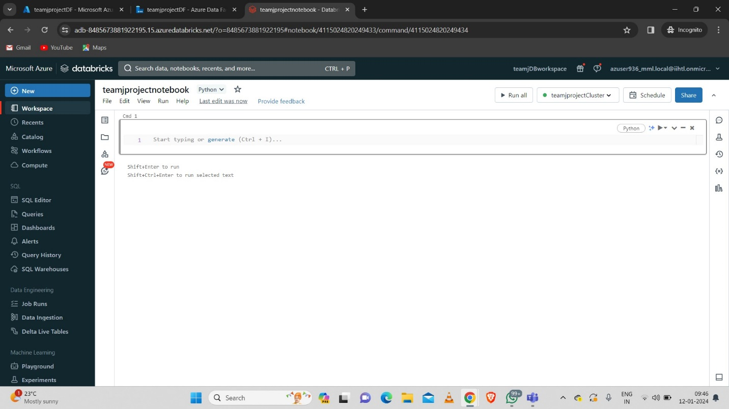
5. Creating Databricks Cluster And Notebook:
Create a Databricks Cluster and Notebook.

Slide 13
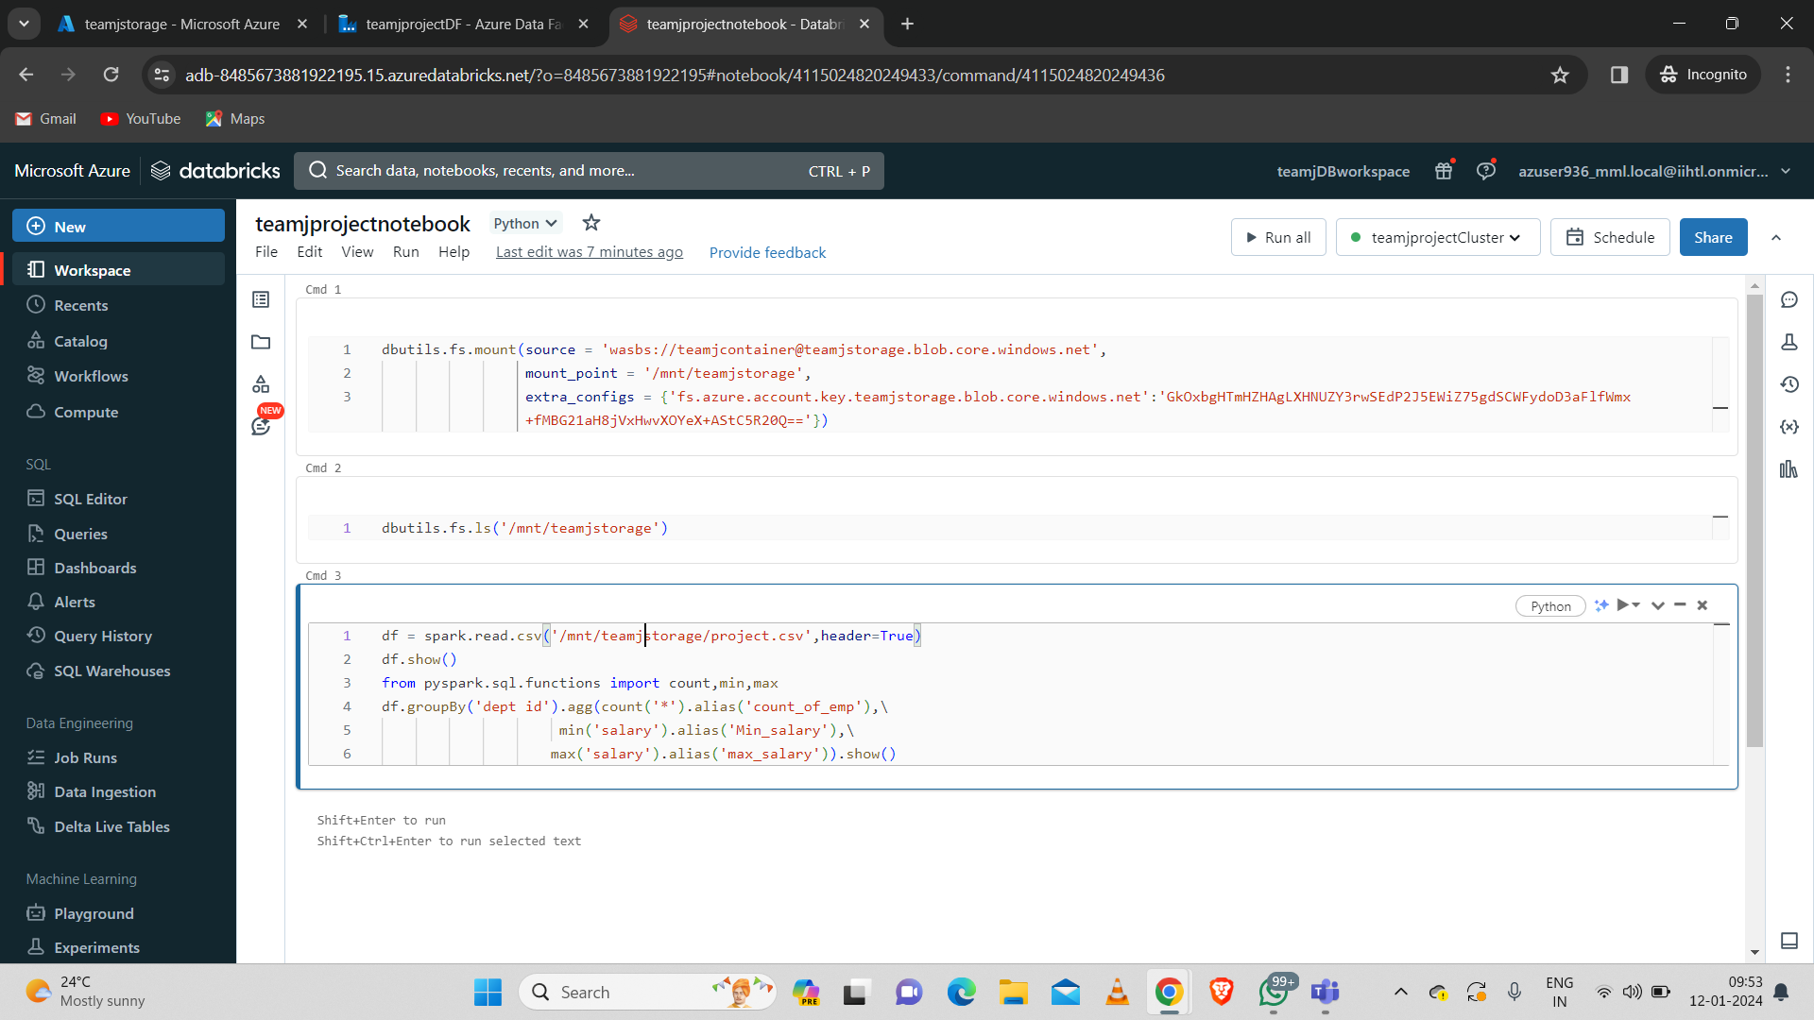
6. Mounting ADLS With Databricks
Mount (Connect) the blob storage container with databricks with following command.

Slide 14
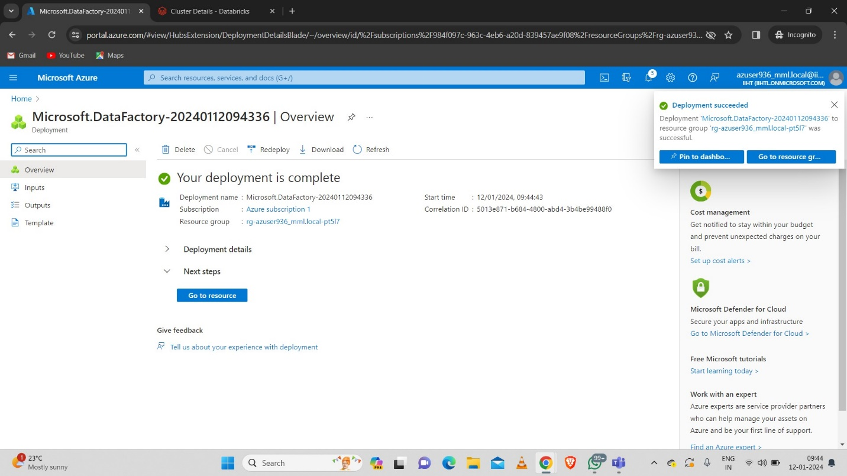
7. Azure Data Factory
Create an Azure Data Factory.

Slide 15
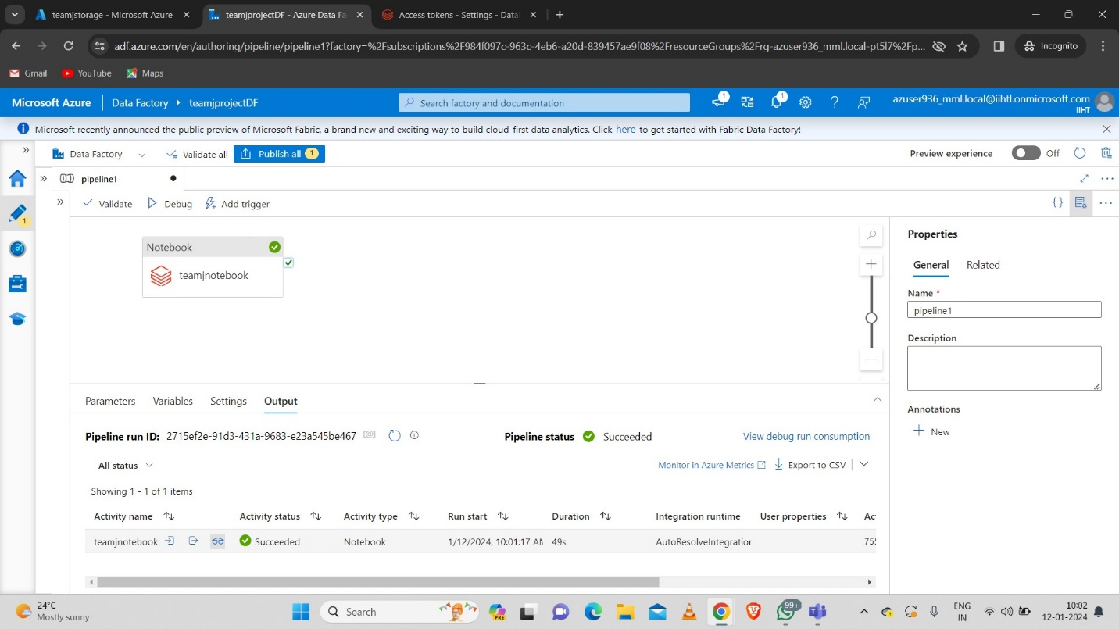
8. Integrating ADF With Azure Databricks

Slide 16
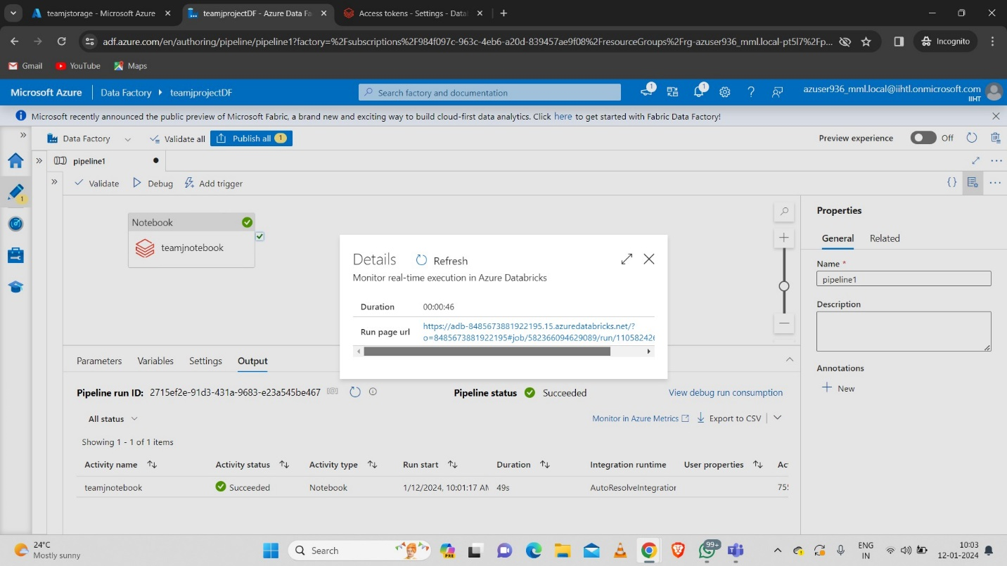
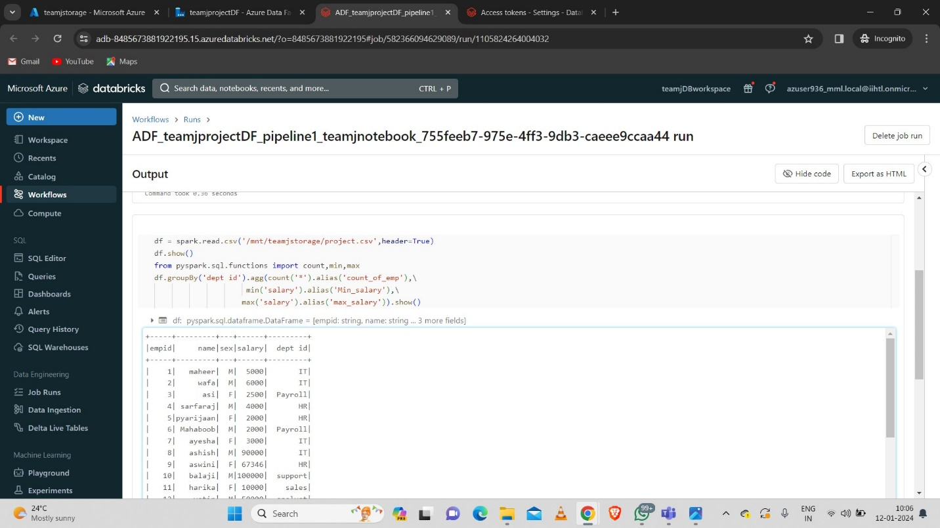
9. Final Output
Click on details at the output of the pipeline after debugging.
Click on the url.

Slide 17
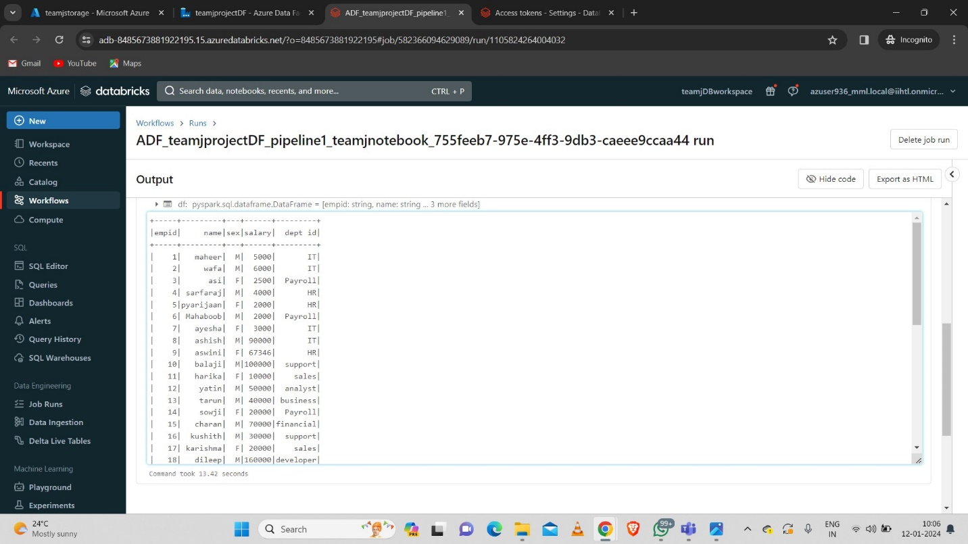
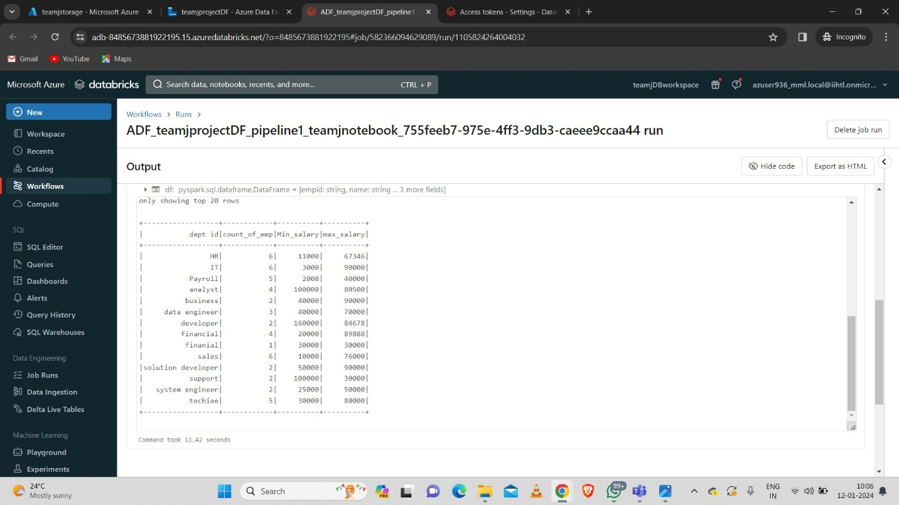
Output:

Slide 18
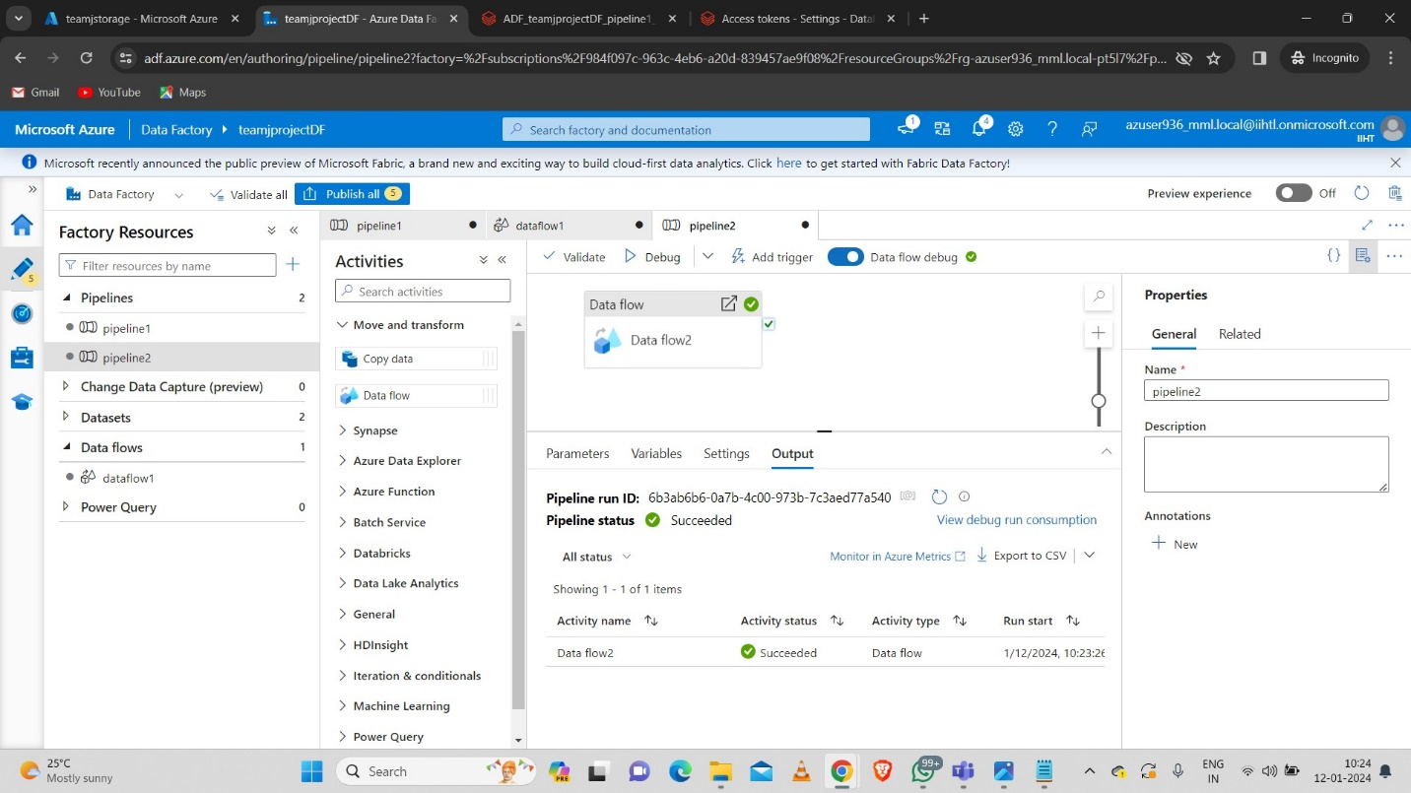
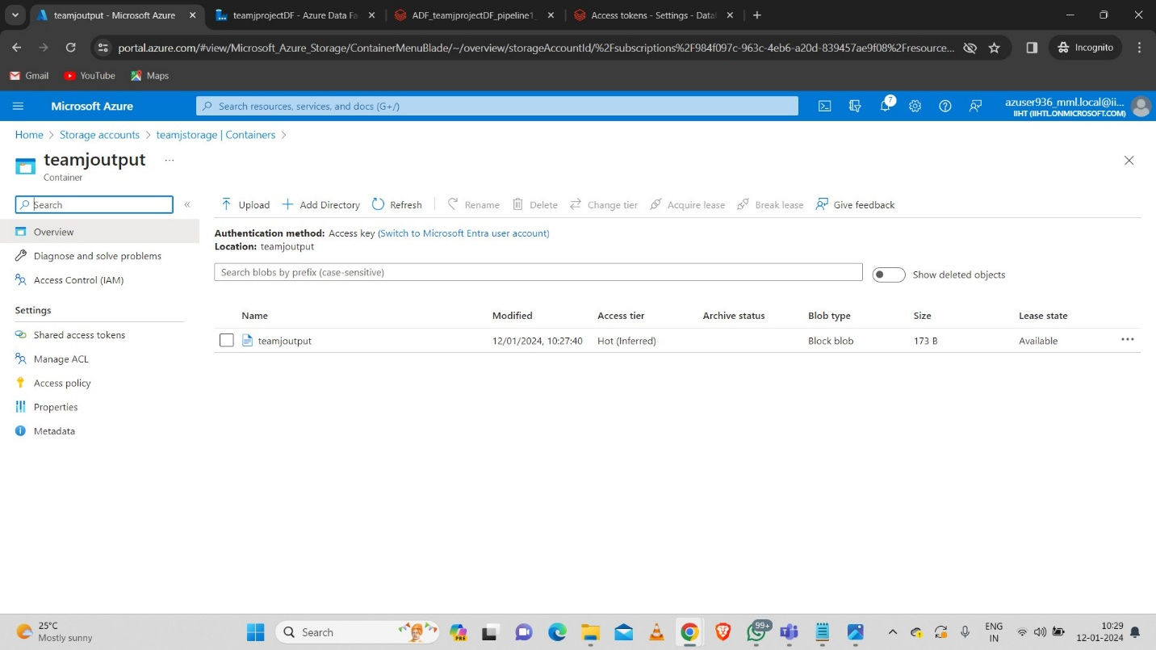
10. Copying The Aggregate Data Using Data Flow Activity

Slide 19
Conclusion
In conclusion, implementing a daily data aggregation pipeline using Azure Data Factory and Azure Databricks offers a robust and scalable solution for handling raw data and deriving meaningful insights on a daily basis. This integration provides a seamless workflow that combines the data movement capabilities of Azure Data Factory with the powerful data processing and analytics features of Azure Databricks.

